Slide 1

Defense diploma thesis Daniel Fischer
Fakultät Maschinenwesen
Professur für Transportprozesse an Grenzflächen
Numerical simulation of radial A + B → C reaction fronts

Slide 2
Content
Introduction
System
Governing equations
Mesh dependency and validation
Simulation results
Conclusion & Outlook

Slide 3
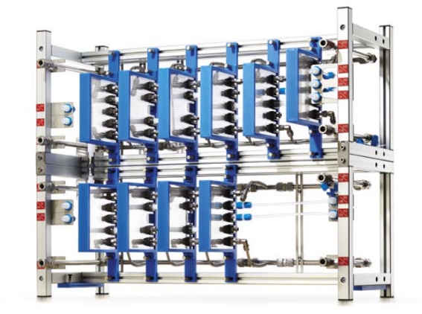
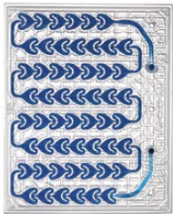
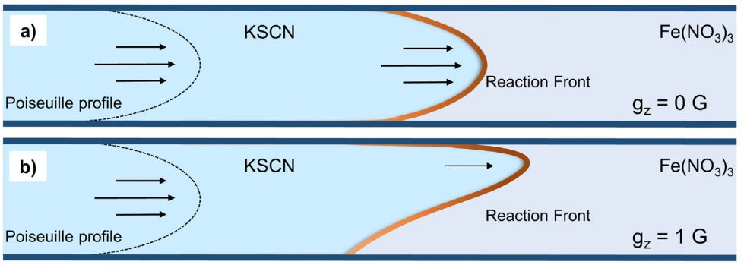
Introduction
Drive towards resource efficiency leads to the need of new materials
Replacement of fossil based materials
New regulations for environmentally harmful materials (PFAS, …)
Scale-up from lab to industrial/pilot scale needed
Research in microfluidic systems
Previous research covers large time scales
Interest in early time stages
Interest in turning of gravity
Microflow reactor [1]
Microfluidic element [1]
Gravitational influence [2]

Slide 4
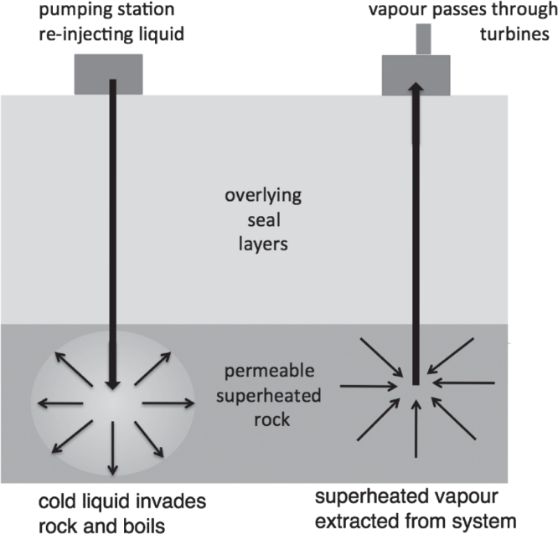
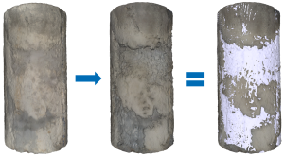
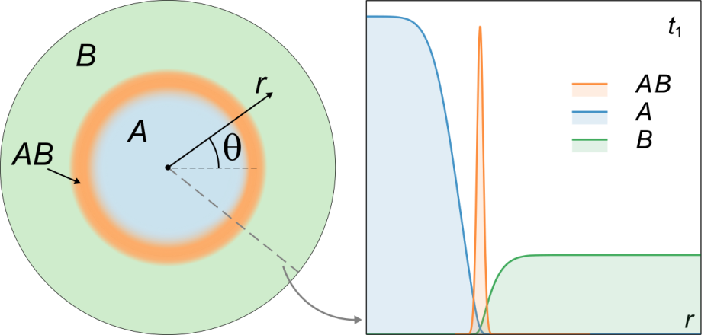

Reaction-Diffusion-Advection fronts
RDA theory can be applied in various different fields
Population dynamics [4,5]
Epidemiology [6,7]
Geological systems
Technological systems
Describe species distribution in space and time
ibz-freiberg.de
C
C
Brau, De Wit, J Chem Phys (2020)

Slide 5
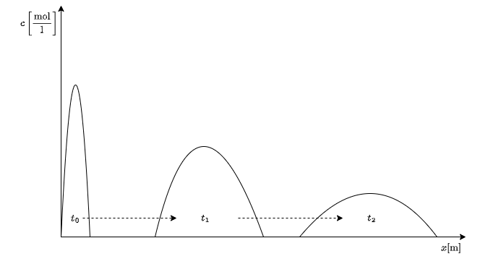
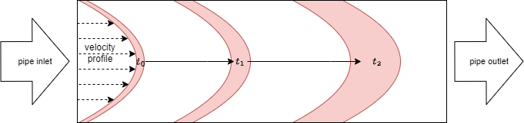
Taylor dispersion
Spreading property in space and time
Spreading of a front within a pipe
Spreading of gap averaged values

Slide 6
System
modelling plane
x
r
Radial geometry
Domain filled with reactant B
Reactant A injected radially into B (A + B → C)
All species (A, B and C) have the same thermophysical properties
Gravitional forces are turned off
ANSYS FLUENT used to implement model
Axisymmetric assumption → 2D Case sufficient to model
3 gap height investigated (0.2mm, 0.4mm, 0.6mm)
property | value
Molar mass [g/mol] | 100
Density [kg/m³] | 1000

Slide 7
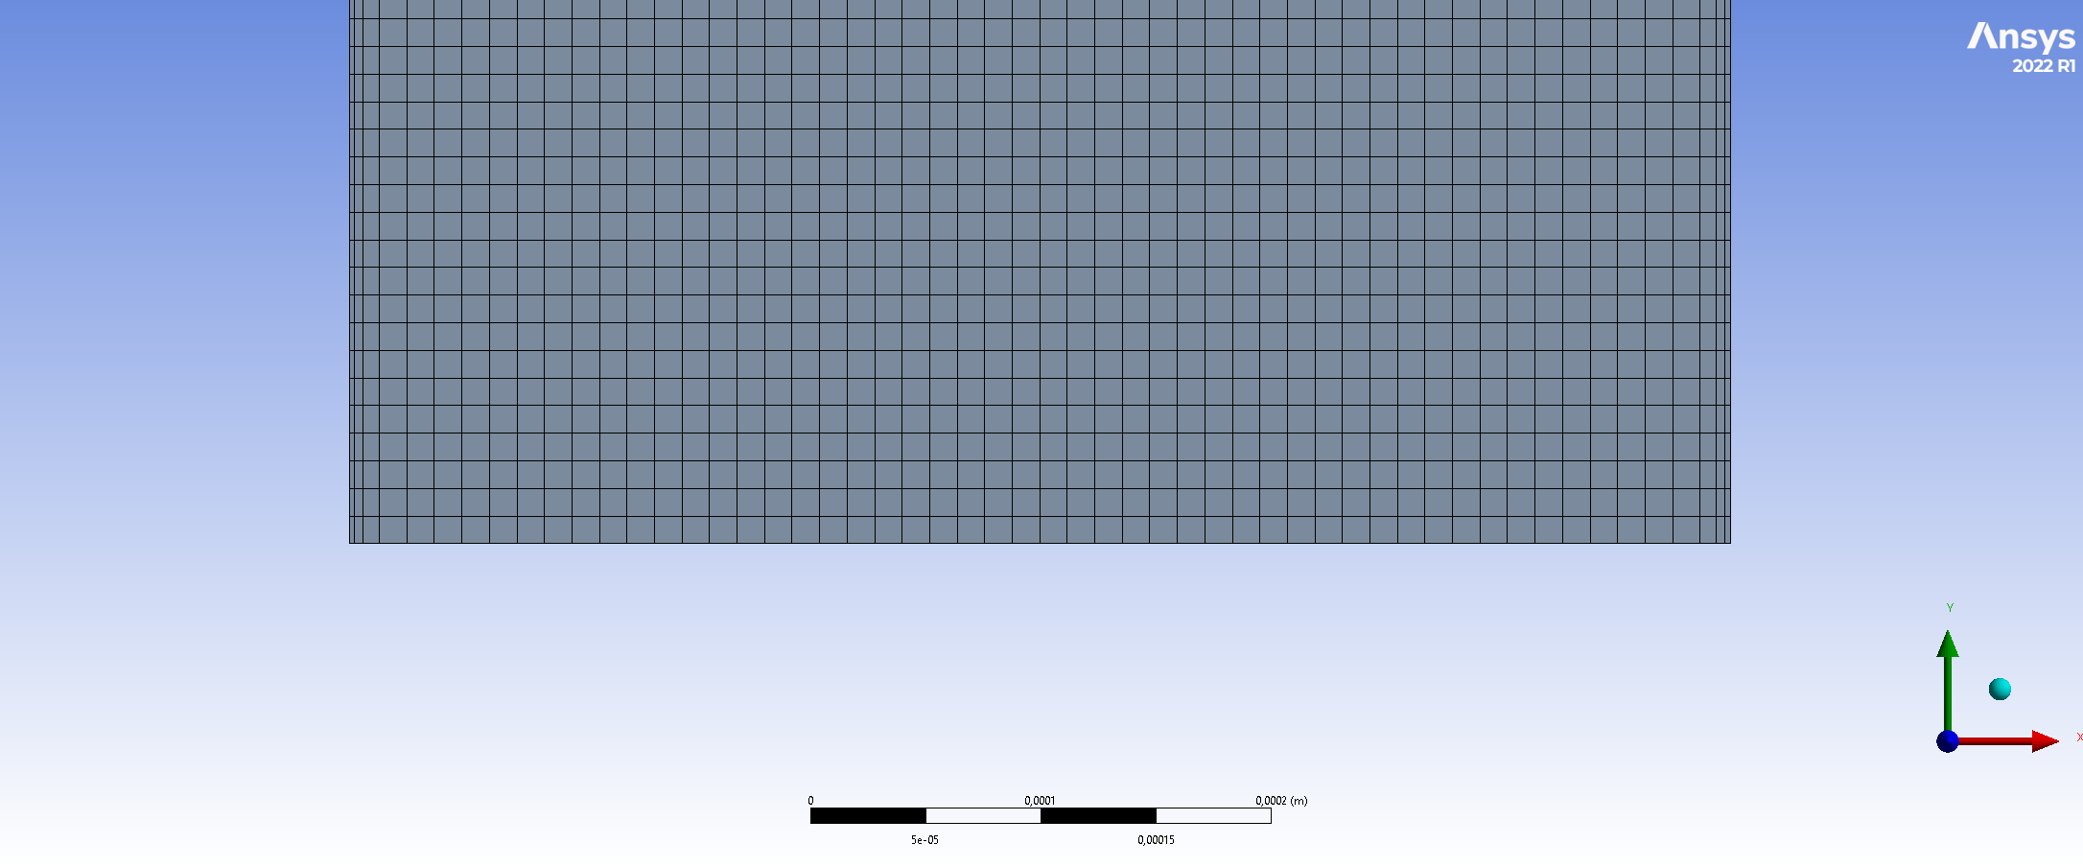
Mesh creation
r
case | n cells | cell size
h=0.2mm | 1.310.000 | 3e-6 [m]
h=0.4mm | 581.679 | 8e-6 [m]
h=0.6mm | 1.116.684 | 5e-6 [m]
x

Slide 8
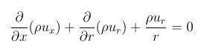
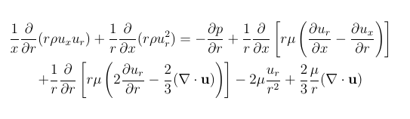
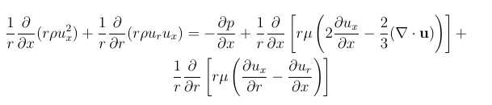
Governing equations
Mass conservation
Continuity equation
Momentum equations
Radial momentum equation
Axial momentum equation

Slide 9
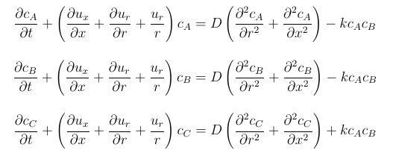
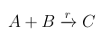
Governing equations
Species distribution equations
Reaction equation
advection term
diffusion term
reaction term

Slide 10
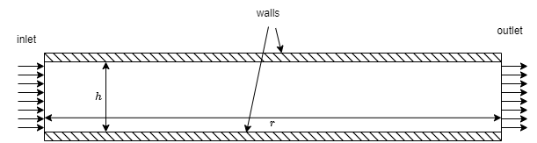
Boundary conditions
Inlet velocity magnitude
Lower limit: 8.33e-5 [m/s]
0.047 [ml/min]
Upper limit: 4.21e-2 [m/s]
0.793 [ml/min]
Pressure outlet
20 [Pa]
No slip
Isothermal
300 [K]
c_{B} = 0.03 [mol/l]
Inlet concentration
c_{A} = 0.03 [mol/l]

Slide 11
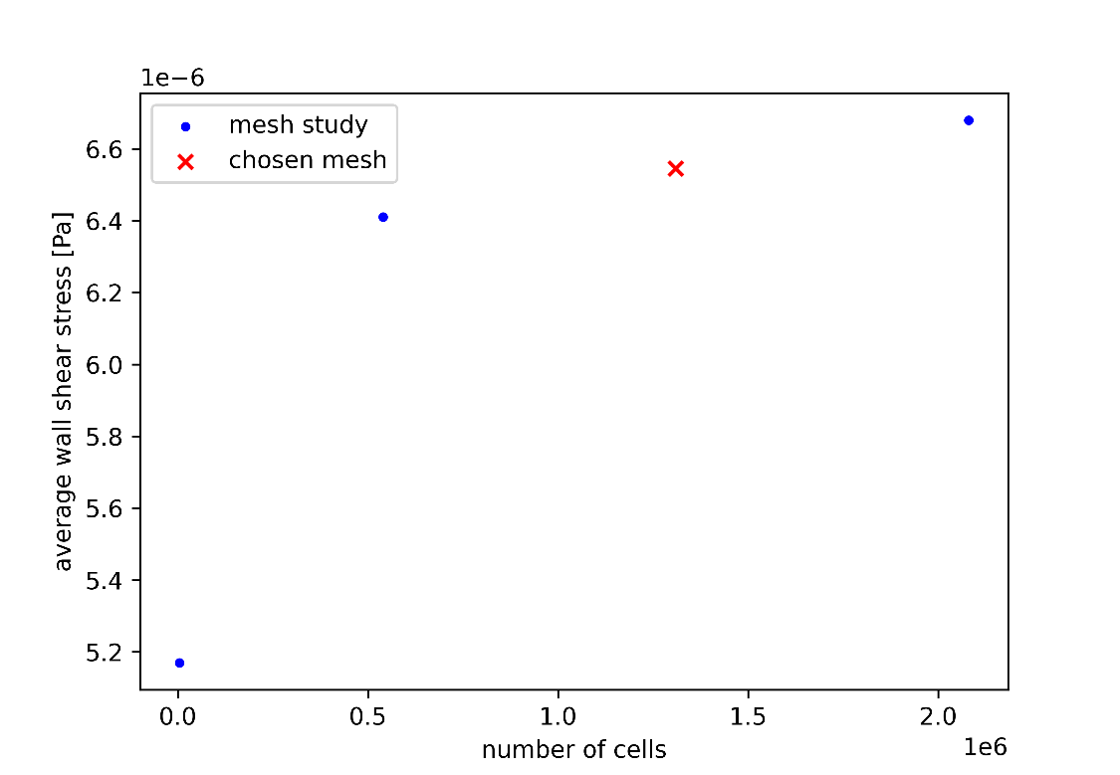
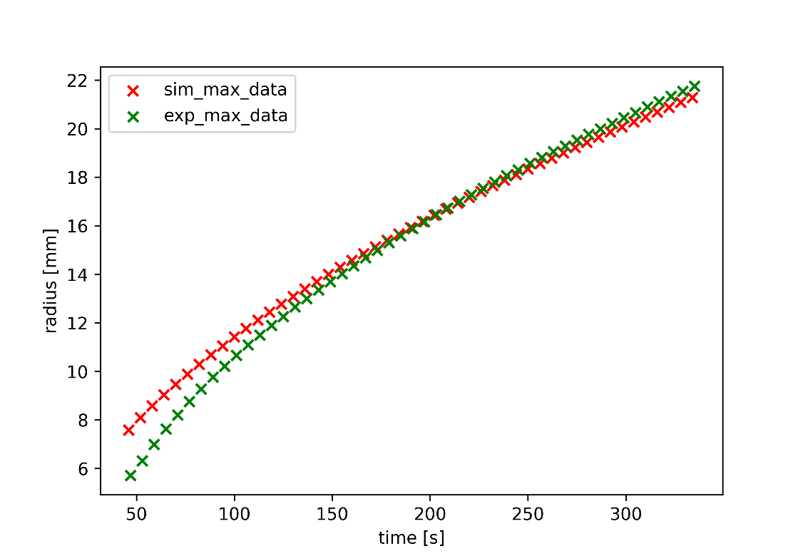
Mesh dependency and validation
Different mesh densities investigated
Validation against existing experimental data (Ý. Stergiou et al. 2023 (unpublished))
h = 0.2mm
(Ý. Stergiou et al. 2023 (unpublished))
h = 0.2mm

Slide 12
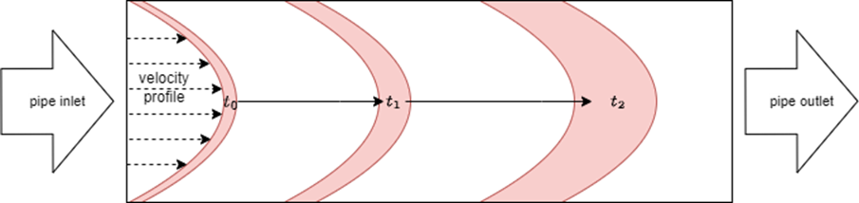
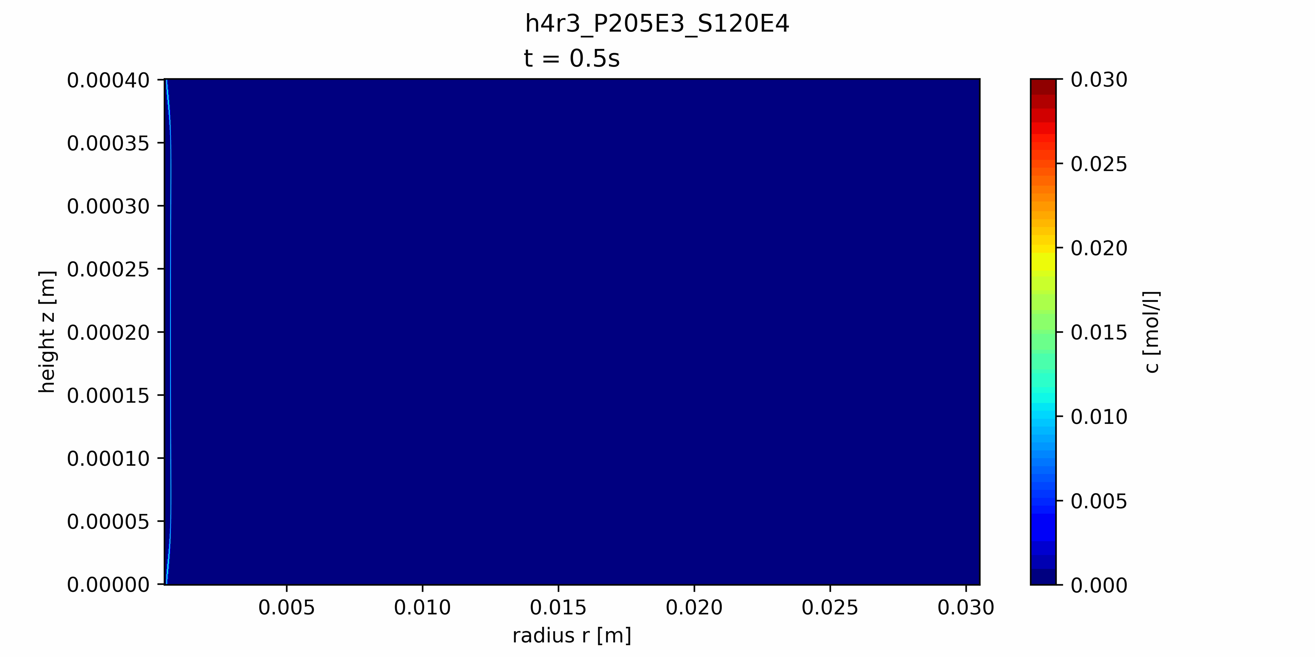
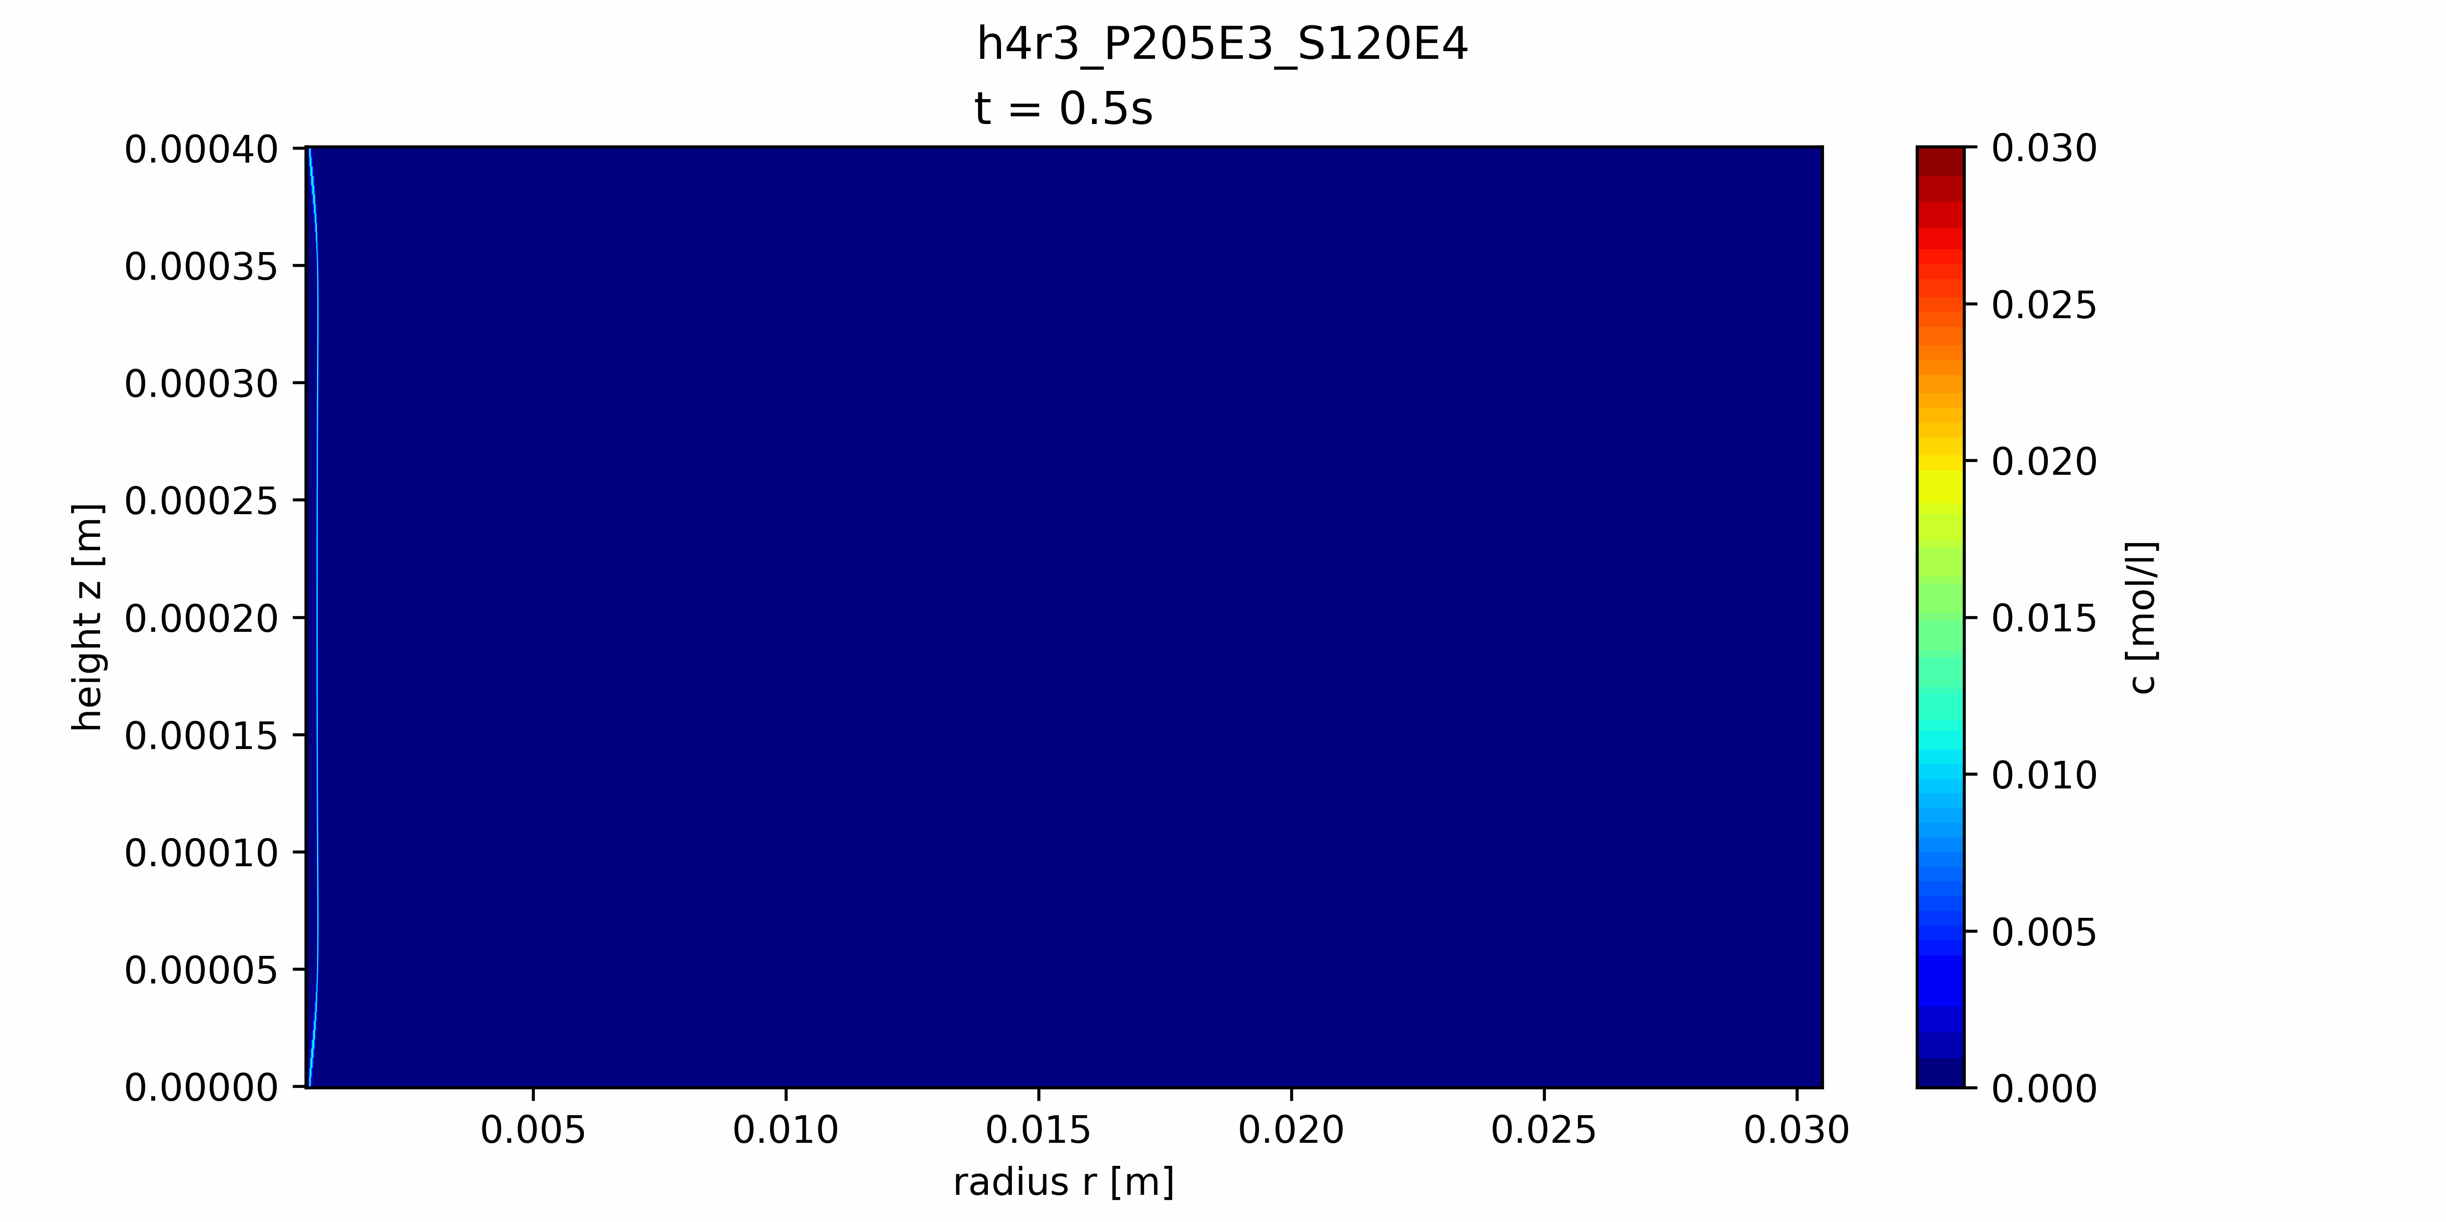
Results

Slide 13
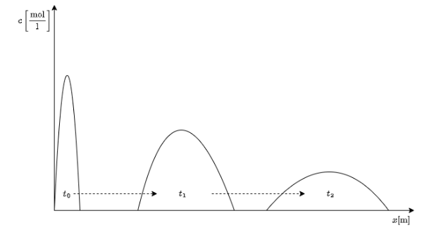
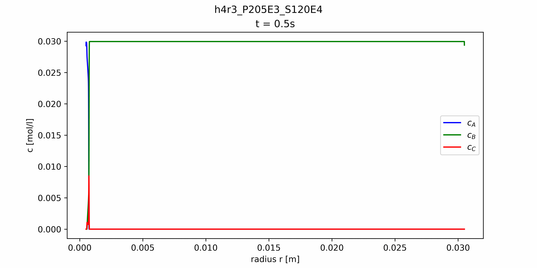

Results
Gap averaged values

Slide 14
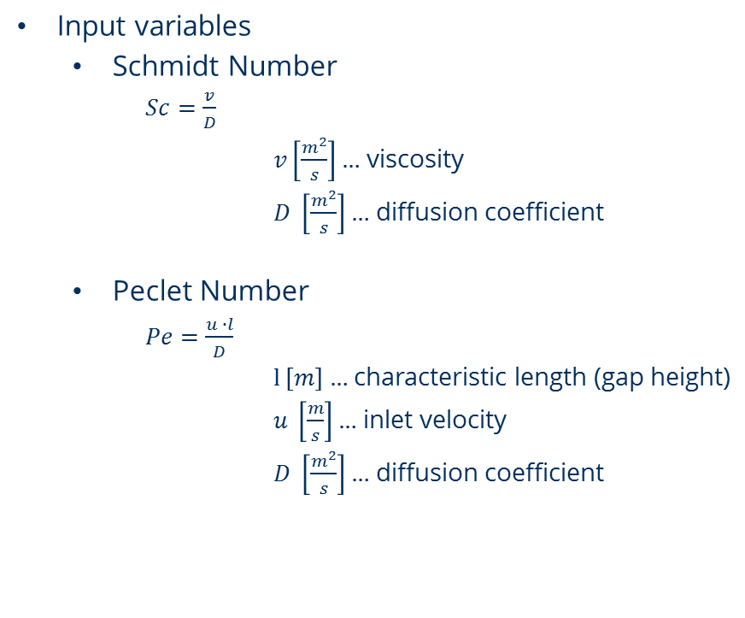
Parametric study
Input variables
Schmidt Number
$Sc=\frac{v}{D}$
$v\left[\frac{m^{2}}{s}\right]…$ viscosity
$D \left[\frac{m^{2}}{s}\right]…$ diffusion coefficient
Peclet Number
$Pe=\frac{u ∙l}{D}$
$l \left[m\right]…$ characteristic length (gap height)
$u \left[\frac{m}{s}\right]…$ inlet velocity
$D \left[\frac{m^{2}}{s}\right]…$ diffusion coefficient
Investigated parameters
Fronts front & maximum positions
Front widths
Total product formed

Slide 15
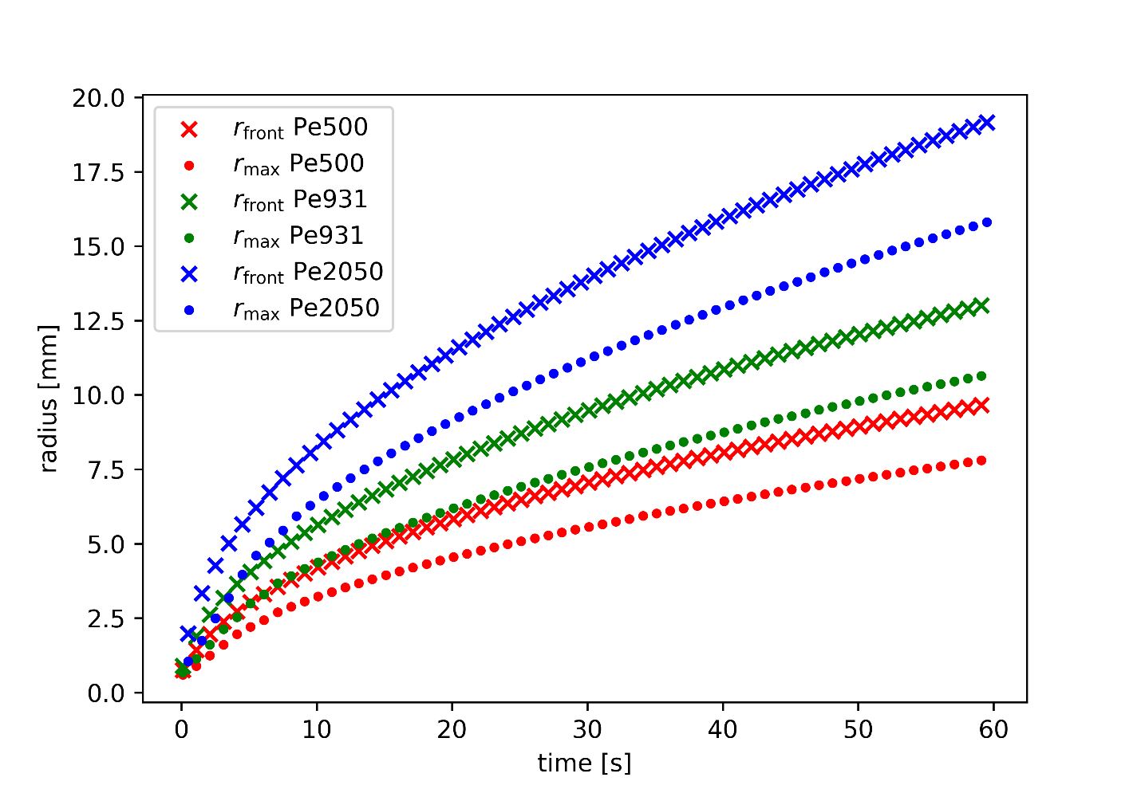
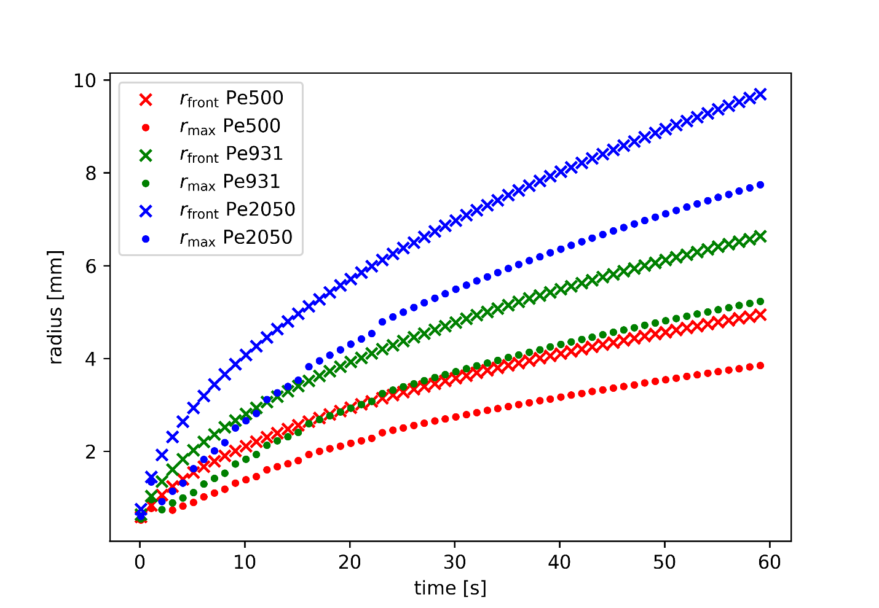
Front positions h = 0.2mm
Sc = 2430
Sc = 12000
No change in principle behaviour based on Sc number
Pe influences front’s travelling speed

Slide 16
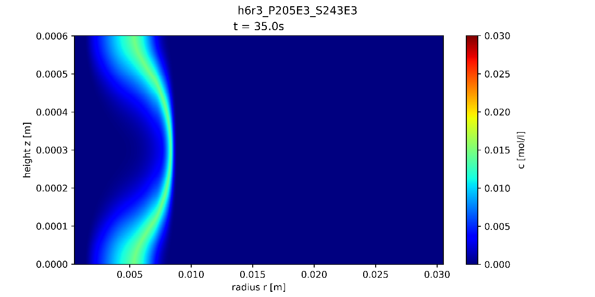
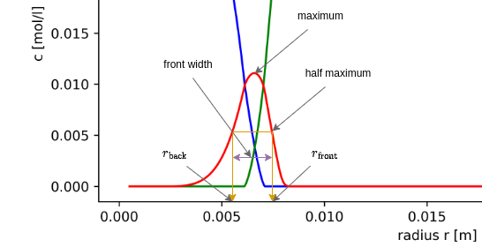

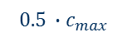
Front widths
Full Width at Half Maximum (FWHM)
Full Width at Half Maximum at Half Gap Height (FWHMHGH)
c [mol/l]
$$c_{max}$$
gap averaged concentration data
FWHMHGH
$$0.5 ∙c_{max}$$
Concentration data at half gap height
r [m]

Slide 17
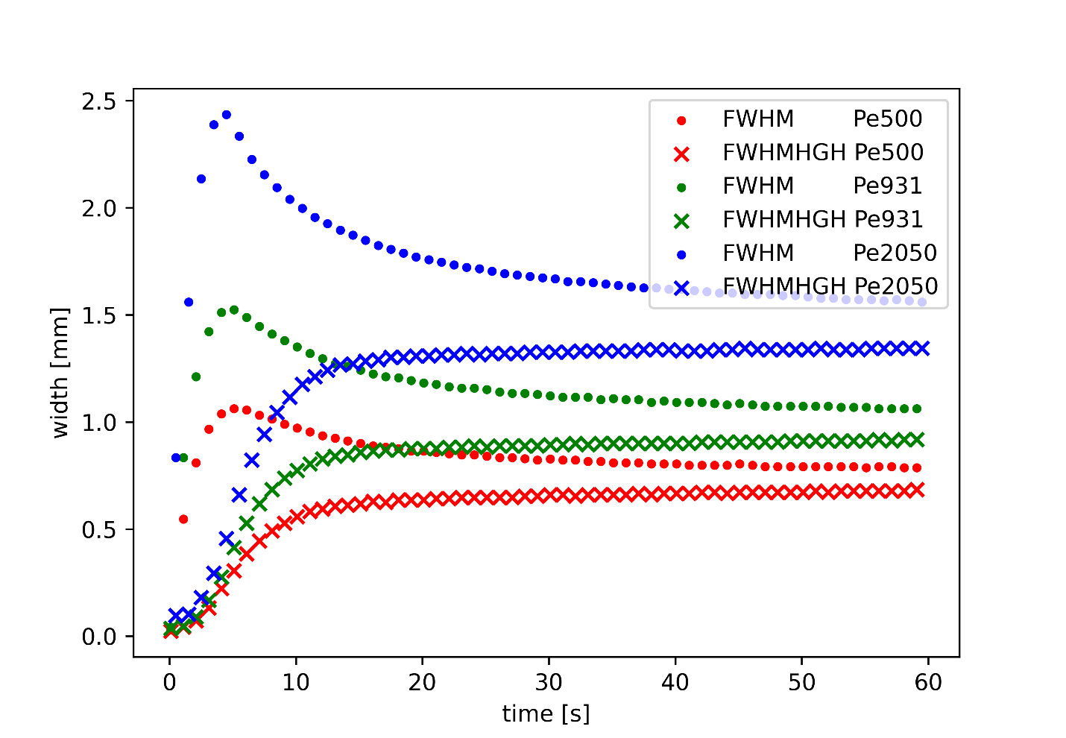
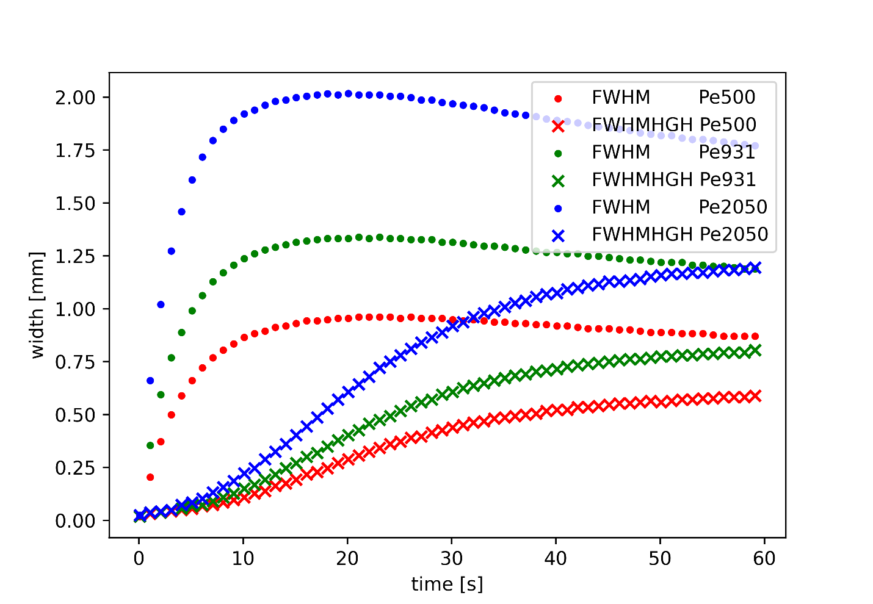
Front widths h = 0.2mm
Sc = 2430
Sc = 12000
Clear Peak for FWHM at lower Schmidt number → Peak widens when Sc is increased
FWHMHGH grows toward final constant value in both cases

Slide 18
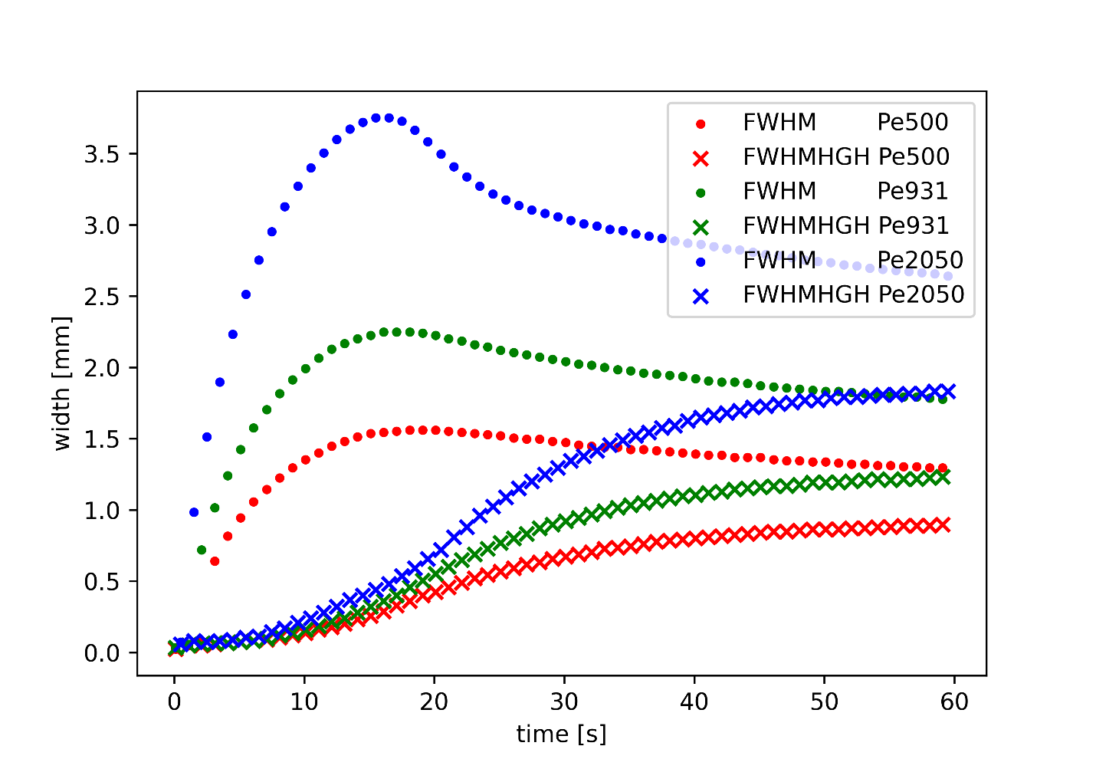
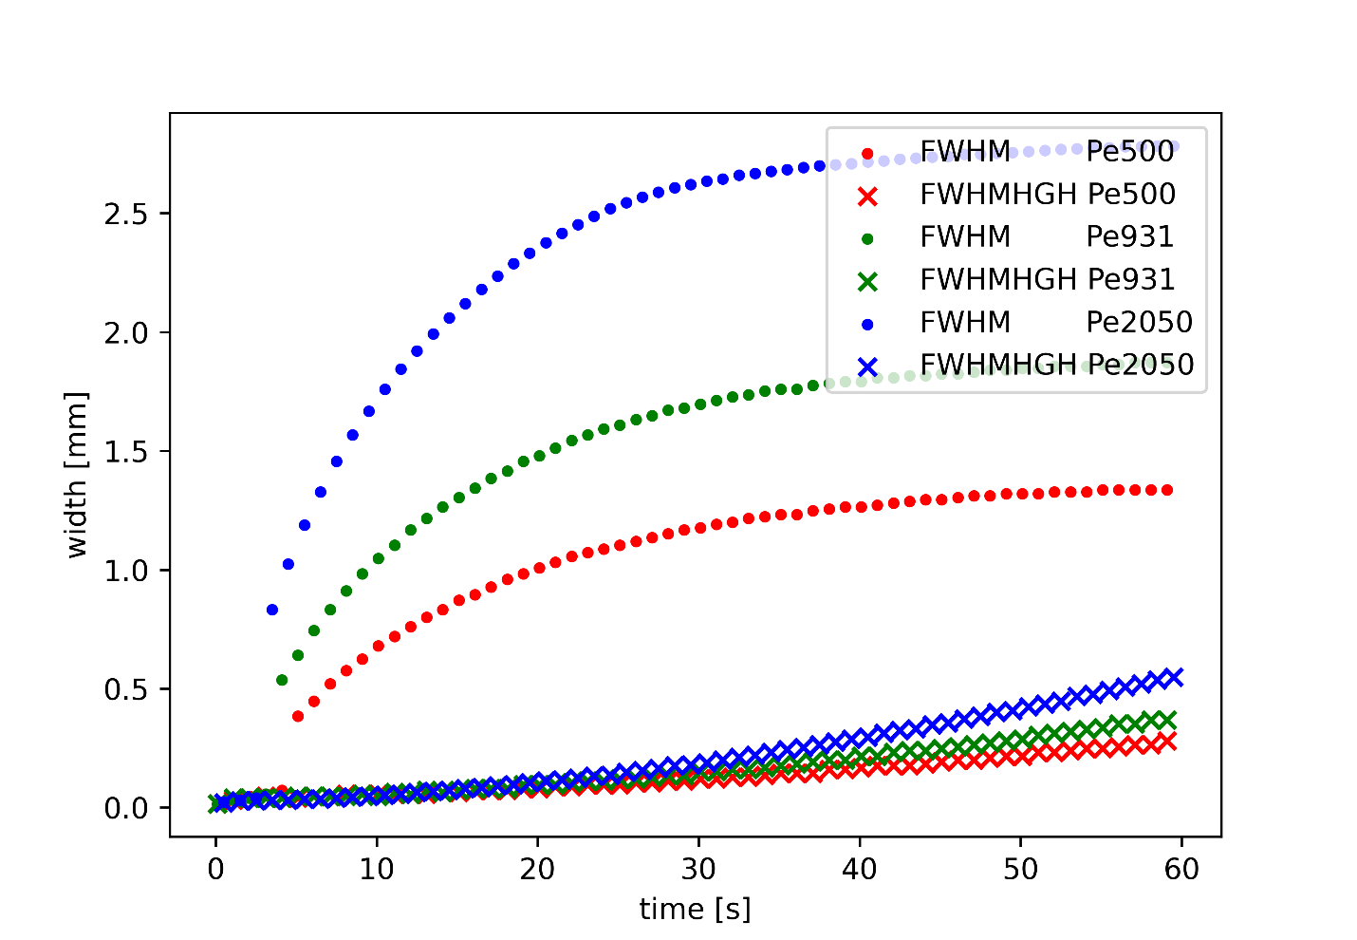
Front widths h = 0.4mm
Sc = 2430
Sc = 12000
Peak is still visible for lower Sc number
For higher Sc FWHMHGH still in early growth phase

Slide 19
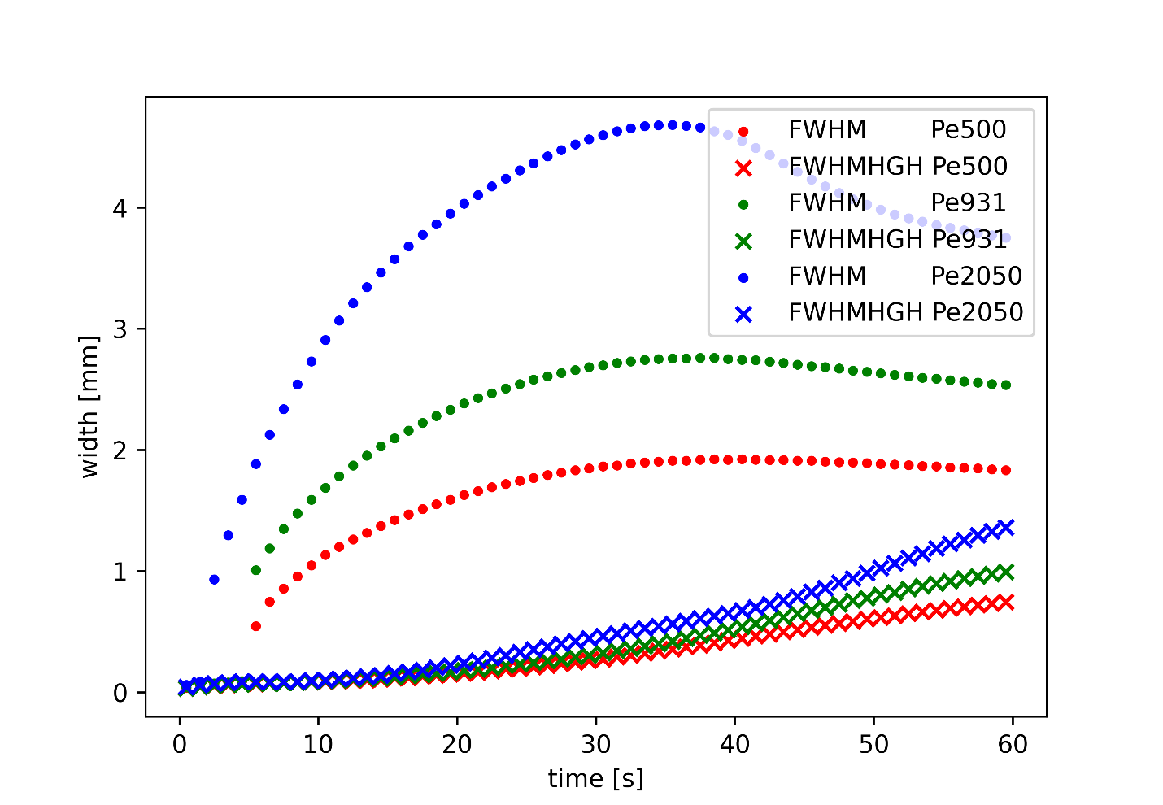
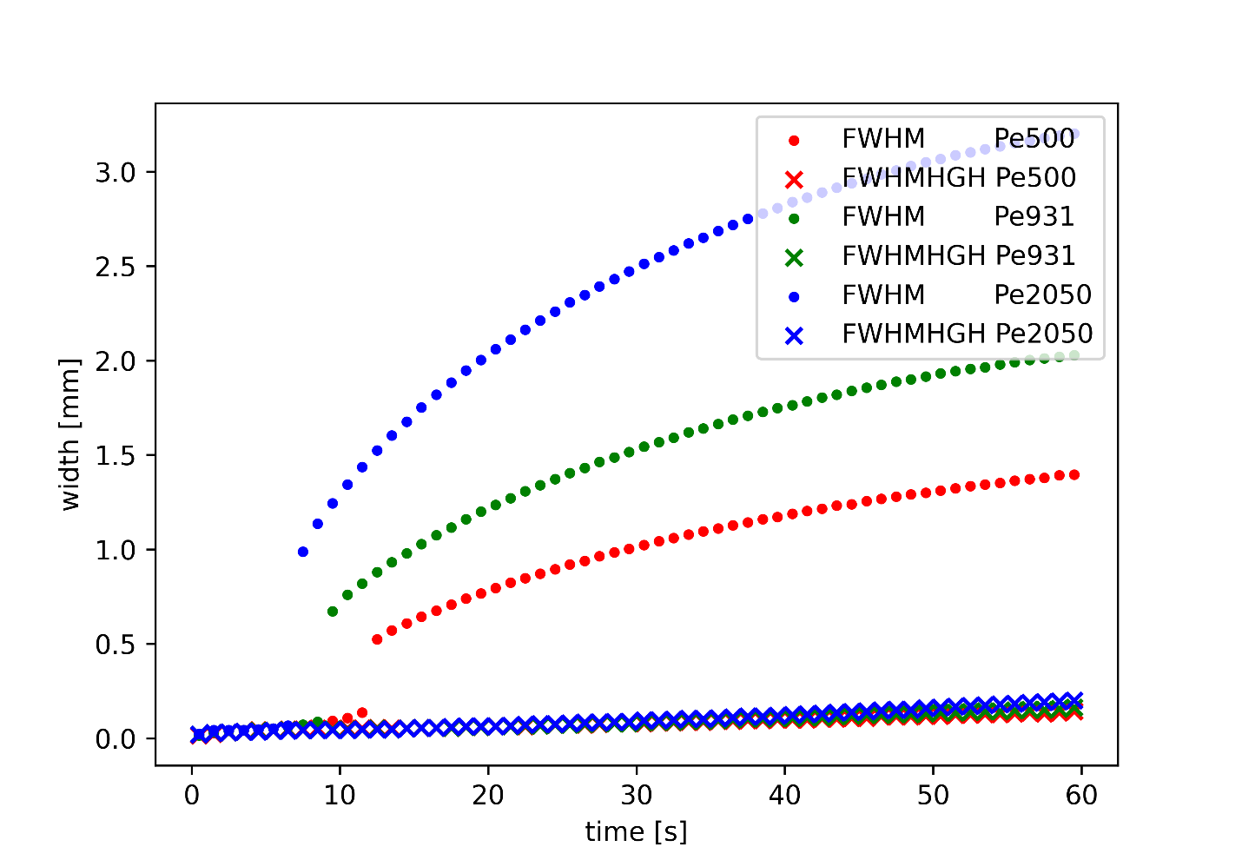
Front widths h = 0.6mm
Sc = 2430
Sc = 12000
Wide spread peak for lower Sc (only clearly visible for highest Pe case)
FWHM growth delayed even more than for h = 0.4mm cases

Slide 20
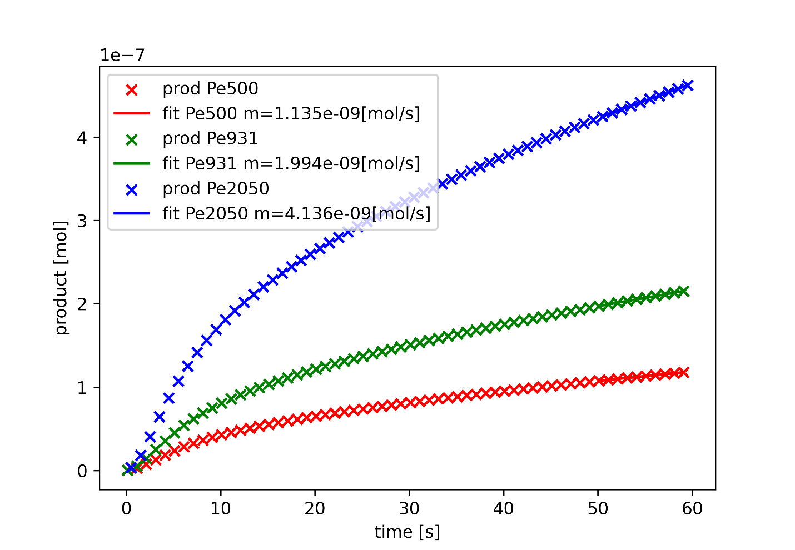
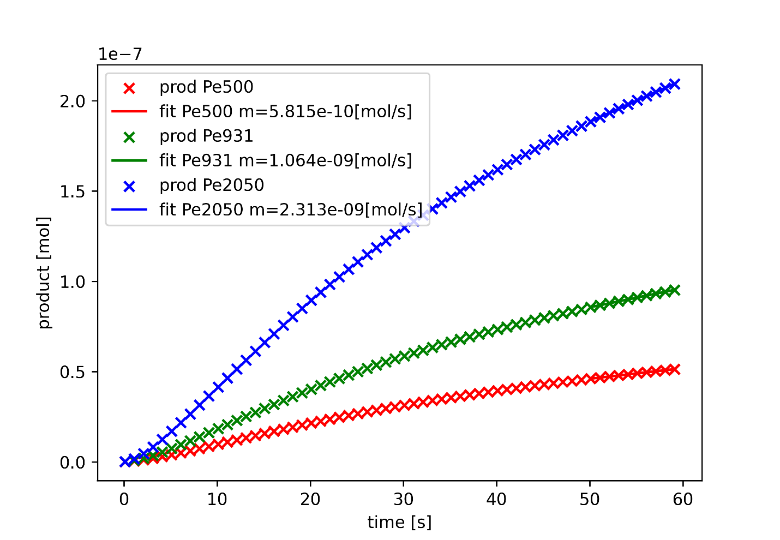
Total product formed h = 0.2mm
Sc = 2430
Sc = 12000
total product formed not influenced much by Sc or Pe
Sc influences the constant production rate towards the end

Slide 21
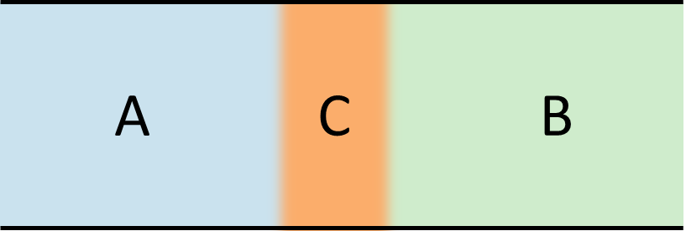
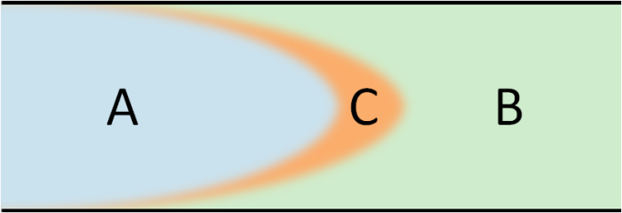
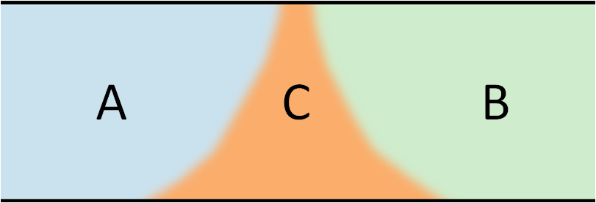
Conclusion & Outlook
Conclusion
Front properties do change dependent of the inlet conditions
Significant influence of Sc on front properties
Pe mostly influences the feature sharpness
Outlook
Further investigations possible with changing
Inlet velocities
Reaction rate/ Reaction mechanism
Initial concentrations
Simulating the cases with gravity
Providing simulation results for future experimental work
1D
2D
2D + buoyancy
Brau, De Wit, J Chem Phys (2020)

Slide 22
Thank you for your attention

Slide 23
Sources
[1] Corning AFR. Advanced fl ow reactors. https://www.corning.com/media/
worldwide/Innovation/documents/G1_WEB.pdf . Accessed: 2022-12-28.
[2] Yorgos Stergiou, Marcus JB Hauser, Alessandro Comolli, Anne Brau, Fabian and,
Gábor Schuszter, Paszkál Papp, Dezső Horváth, Clément Roux, Véronique
Pimienta, et al. Effects of gravity modulation on the dynamics of a radial a+
b→ c reaction front. Chemical Engineering Science, 257:117703, 2022.

Slide 24
Sources
[4] Shanshan Chen, Yuan Lou, and Junjie Wei. Hopf bifurcation in a delayed
reaction–diﬀusion–advection population model. Journal of Diﬀerential Equations,
264(8):5333–5359, 2018.
[5] Yan Wang and Junping Shi. Persistence and extinction of population in reaction-
diﬀusion-advection model with weak allee eﬀect growth. SIAM Journal on Applied
Mathematics, 79(4):1293–1313, 2019.

Slide 25
Sources
[6] Kousuke Kuto, Hiroshi Matsuzawa, and Rui Peng. Concentration proﬁle of en-
demic equilibrium of a reaction–diﬀusion–advection sis epidemic model. Calculus
of Variations and Partial Diﬀerential Equations, 56(4):1–28, 2017.
[7] Julia V Noble. Geographic and temporal development of plagues. Nature,
250(5469):726–729, 1974.

Slide 26
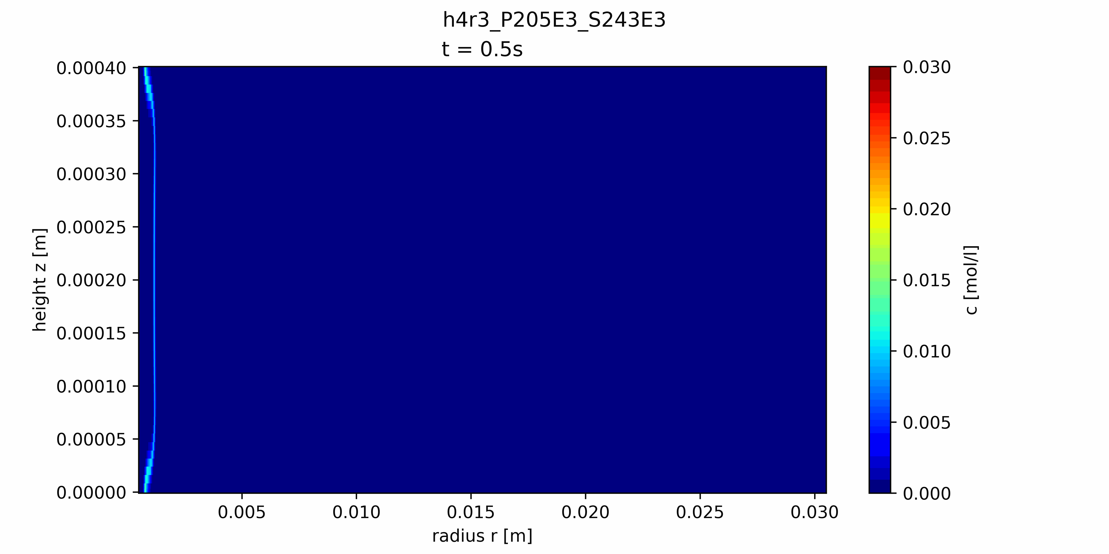

Results

Slide 27
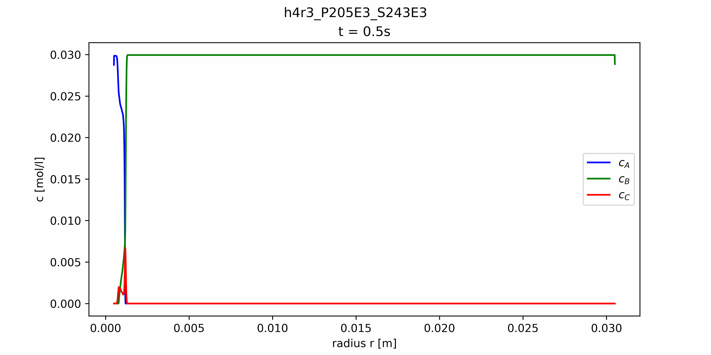

Results

Slide 28
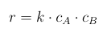
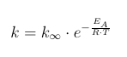
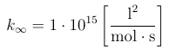
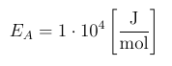
Reaction details
Reaction equation
Reaction rate
Reaction rate constant

Slide 29
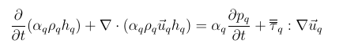
Governing equations
Energy equation

Slide 30
Limitations
Limitations
Simulating a 2D case
Axisymmetric case
Homogeneous velocity field at inlet
Same physical properties
Isothermal conditions

Slide 31
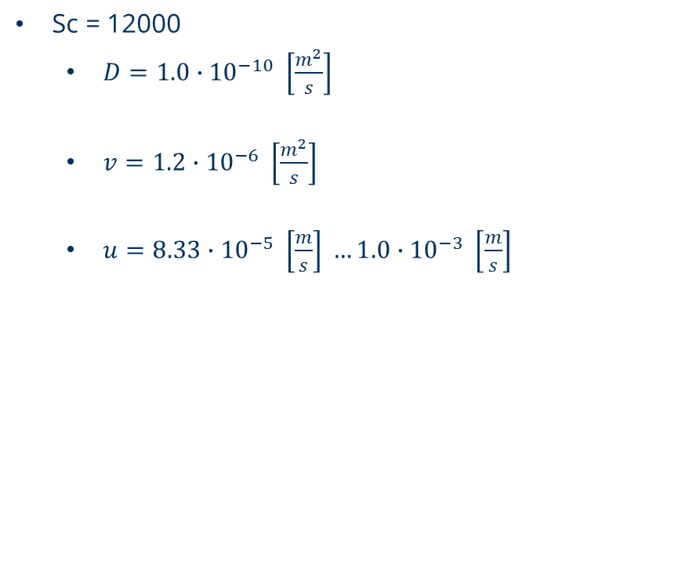
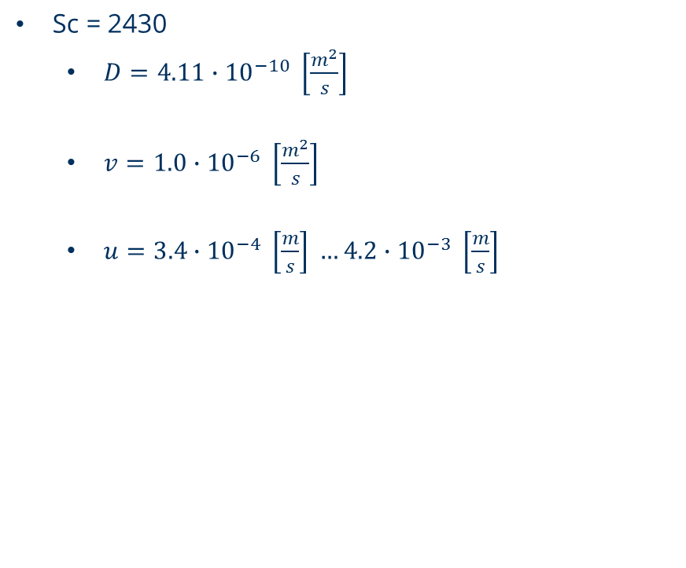
Input parameters
Sc = 2430
$D=4.11∙{10}^{−10} \left[\frac{m^{2}}{s}\right]$
$v=1.0∙{10}^{−6} \left[\frac{m^{2}}{s}\right]$
$u=3.4∙{10}^{−4} \left[\frac{m}{s}\right] …4.2∙{10}^{−3} \left[\frac{m}{s}\right]$
Sc = 12000
$D=1.0∙{10}^{−10} \left[\frac{m^{2}}{s}\right]$
$v=1.2∙{10}^{−6} \left[\frac{m^{2}}{s}\right]$
$u=8.33∙{10}^{−5} \left[\frac{m}{s}\right] …1.0∙{10}^{−3} \left[\frac{m}{s}\right]$

Slide 32
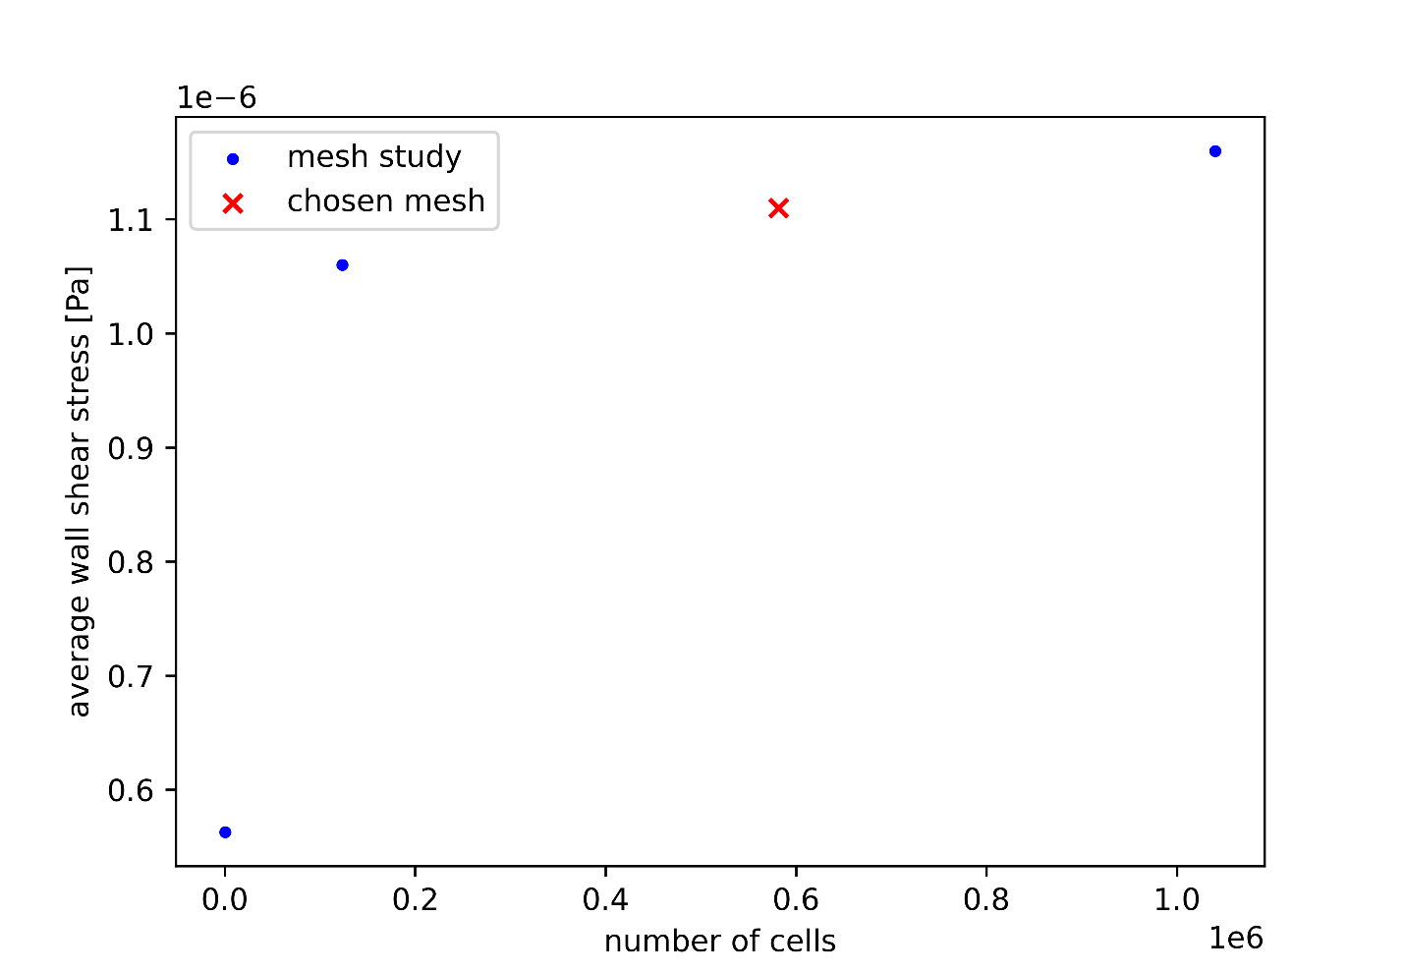
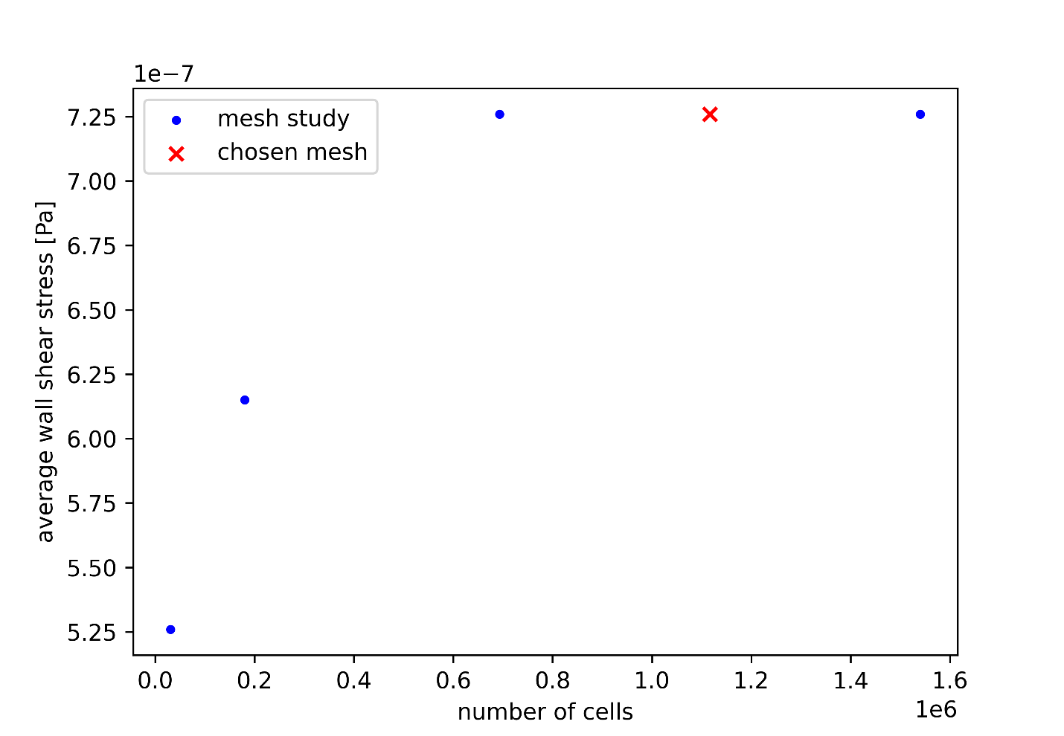
Mesh dependency
h = 0.4mm
h = 0.6mm

Slide 33


Front positions h = 0.4mm
Sc = 2430
Sc = 12000

Slide 34


Front positions h = 0.6mm
Sc = 2430
Sc = 12000

Slide 35


Total product formed h = 0.4mm
Sc = 2430
Sc = 12000

Slide 36


Total product formed h = 0.6mm
Sc = 2430
Sc = 12000

Slide 37

Velocity profile

Slide 38


Width shrinkage/growth

Slide 39



Experimental setup
Hele-Shaw-Cell with
0.2mm gap height
80mm radius
Reaction
${SCN}^{−}+{Fe}^{3+} →FeSCN^{2+}$

Slide 40

Residuals
h = 0.2mm Pe = 500 Sc = 12000

Slide 41

Gravitational influence

Slide 42

Microfluidic element
Microflow reactor

Slide 43

Software Setup

Slide 44


Software Configs
Post processing config
case config

Slide 45

HPC Cluster

